Slide 1

Category Code: C1
Problem Statement Title: Friendly Neighbourhood App – Gamified Crowdsourced Civic Solutions (SDG 11 ,SDG 16)
Team Name: Khaana Khazana
Institute Name: Vivekanand Education Society’s Institute of Technology

Slide 2

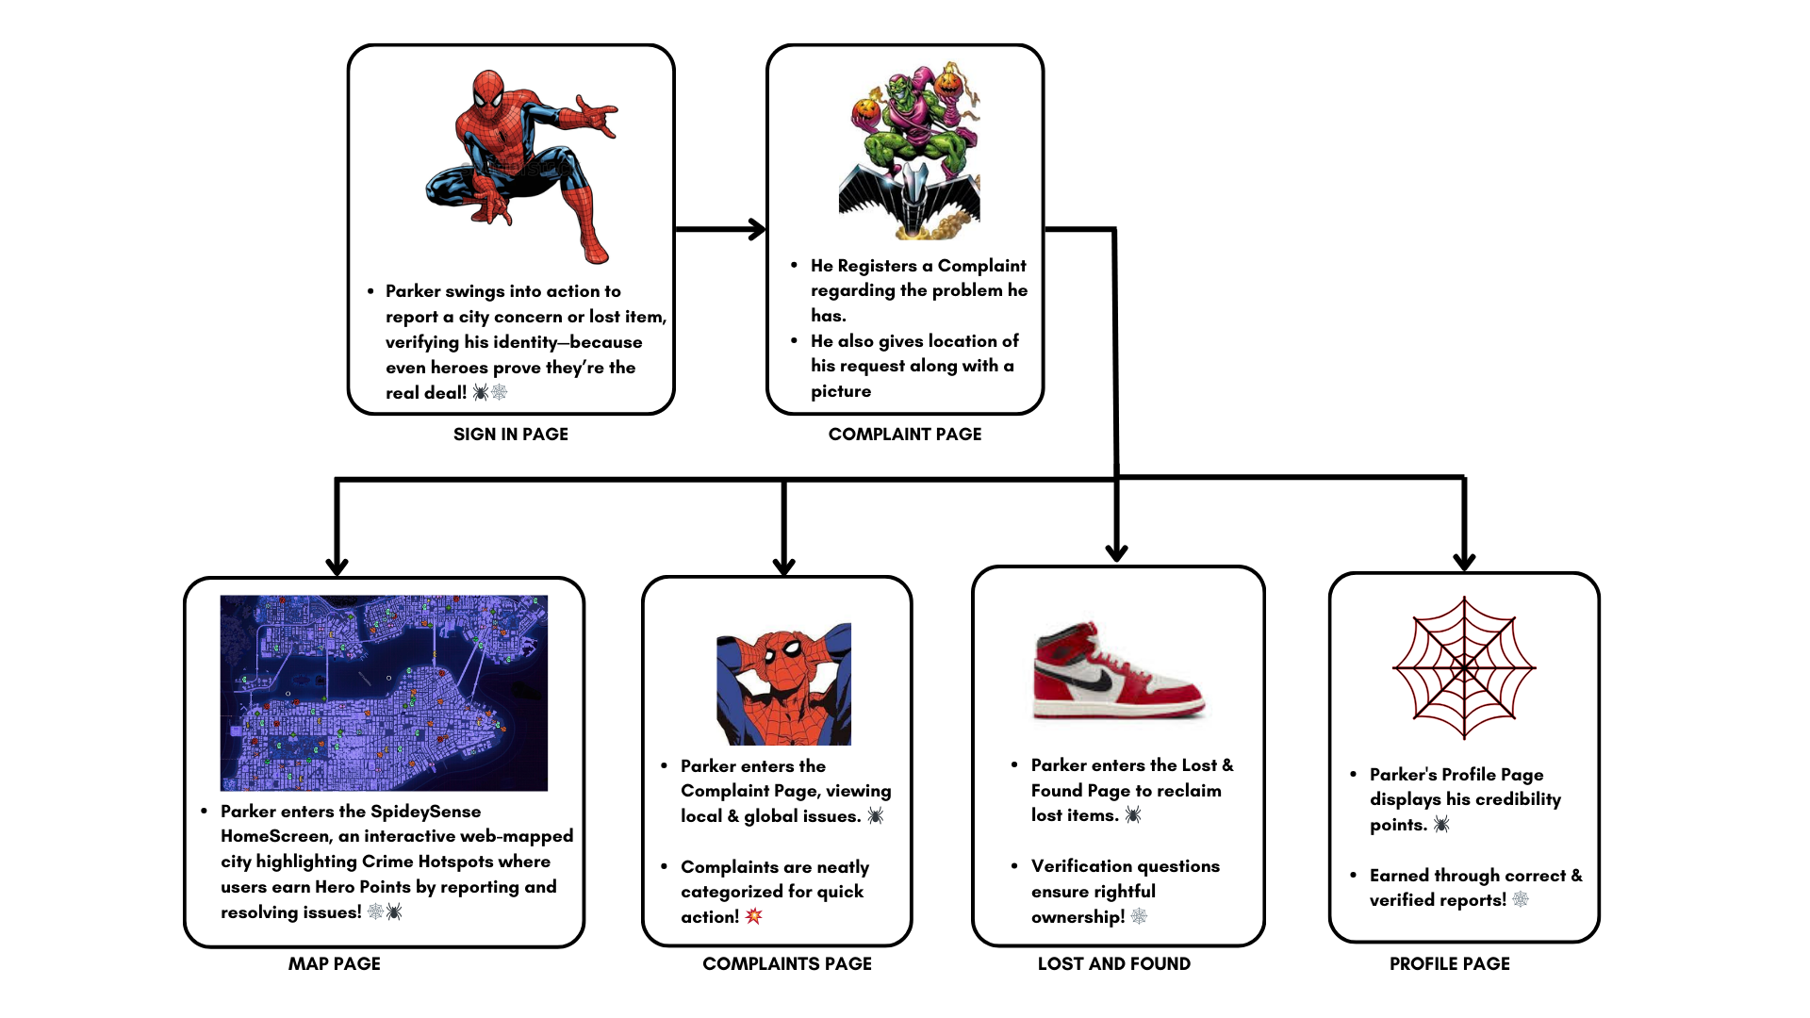
Idea / Approach details (& implemented features)
The current civic technology sector primarily concentrates its efforts on massive infrastructure development alongside one-way information transmission systems.
.
What happens to the everyday disruptive problems which urban citizens experience during their daily routines? Daily problems such as broken roads, leaking water systems and delayed transit services and lost possessions negatively impact quality of life unless proper solutions are found. The everyday problems that urban residents face directly in their environment fail to reach traditional channels because these channels lack real-time feedback and insufficient verification processes and limited community involvement
The interactive gamified platform Friendly Neighbourhood App turns ordinary civic complaints into a game-inspired system that mimics location-based tasks. The system enables citizens to move from simple problem reporting to active issue resolution by engaging in collective community problem-solving.

Slide 3
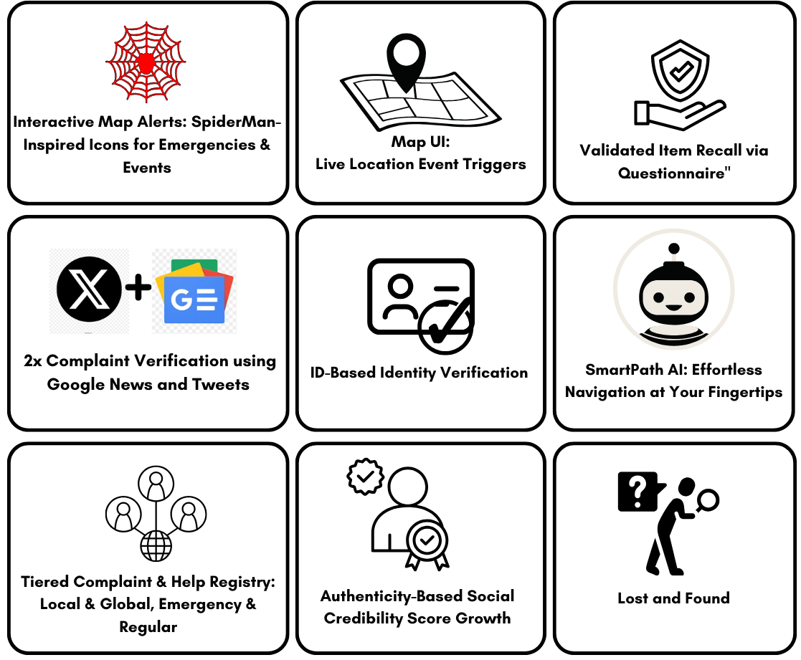
Innovation (Showstopper)
Next-Gen Features :
1) Interactive Map Alerts – SpiderMan-inspired icons for instant emergency & event awareness. 2)Live Map Triggers – Get real-time updates based on your location. 3)Smart Item Recall – AI-driven questionnaire ensures you never forget important items. 4)2x Complaint Verification – Google News & Twitter-powered credibility checks. 5)Secure ID Verification – Fast, reliable, and seamless identity authentication. 6)SmartPath AI Navigation – Hassle-free AI-driven route optimization. 7)Tiered Complaint Registry – Local, global & emergency issue reporting. 8)Social Credibility Score – Earn trust with verified actions. 9) AI-Powered Lost & Found – Never lose track of what matters.

Slide 4









Tech Stack
FRONTEND AND DATABASE
BACKEND APIS

Slide 5
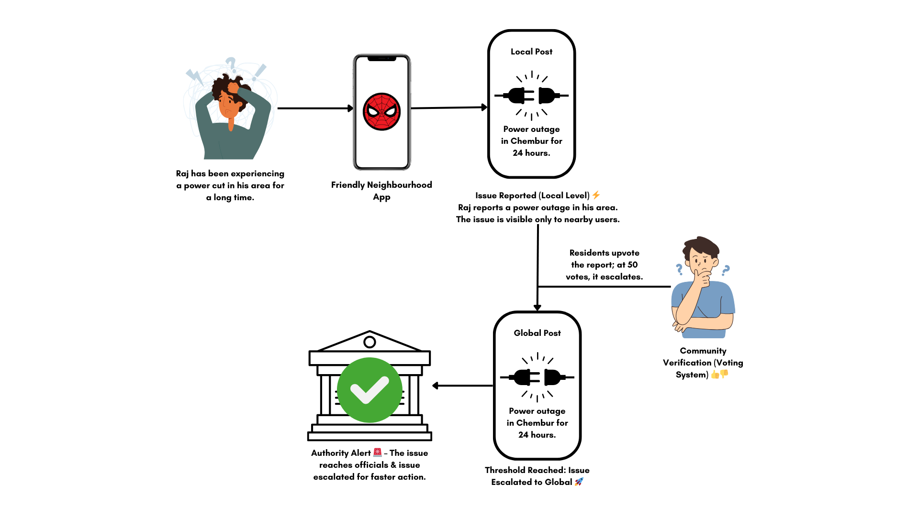
Use Case Diagram
VERIFICATION BASED ISSUE ESCALATION

Slide 6
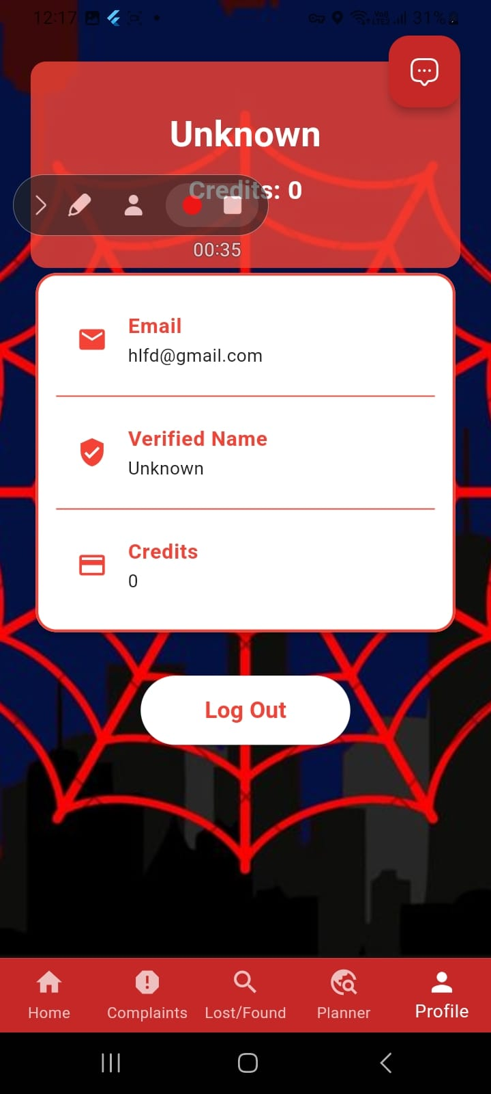
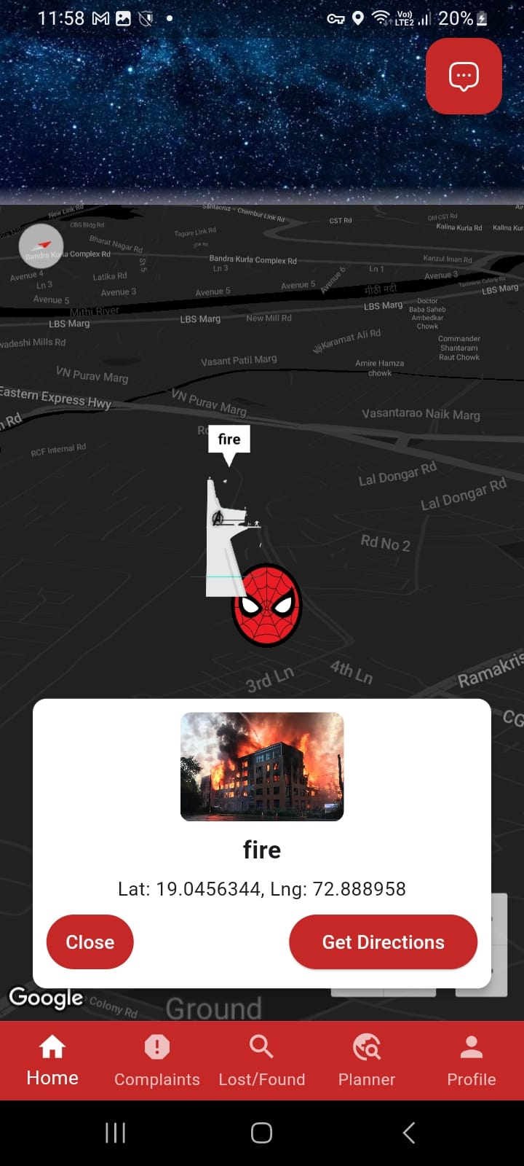
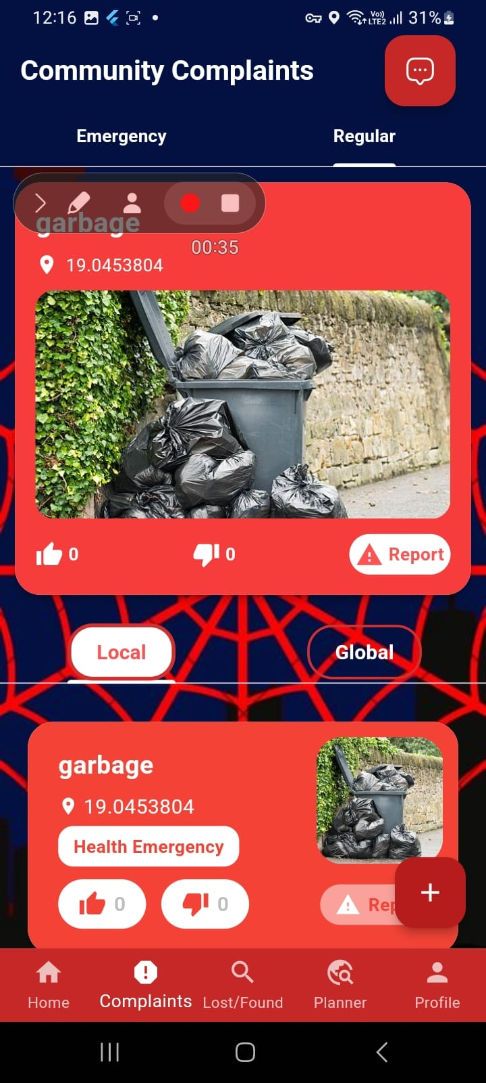
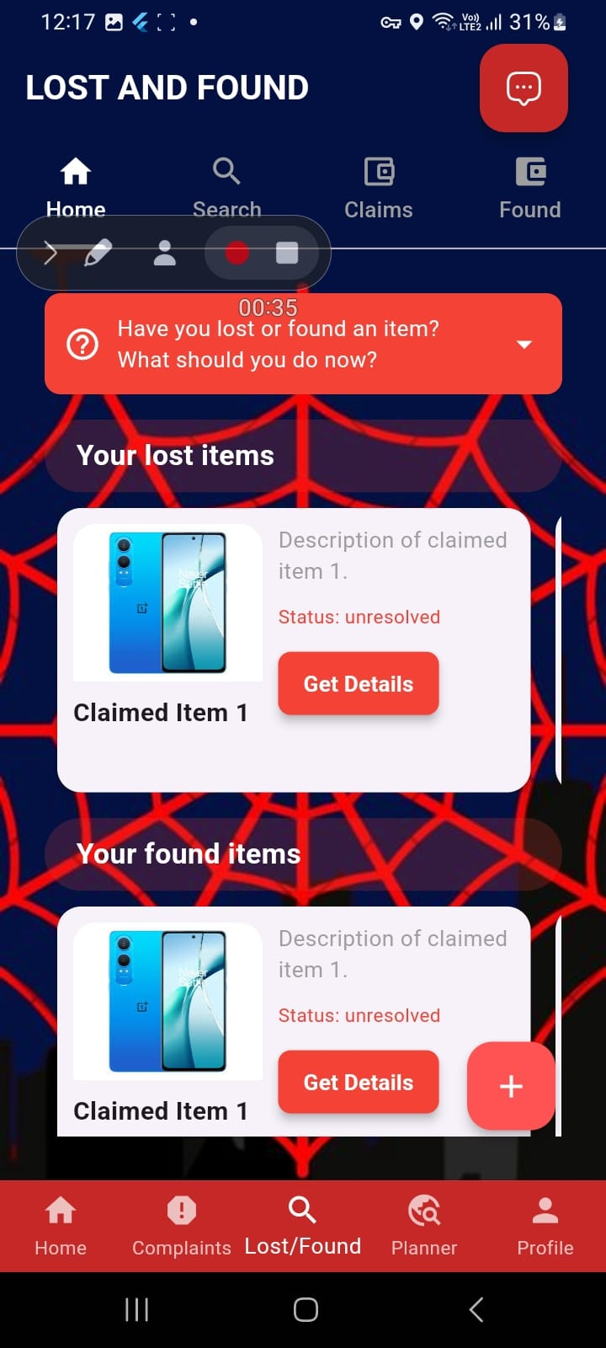
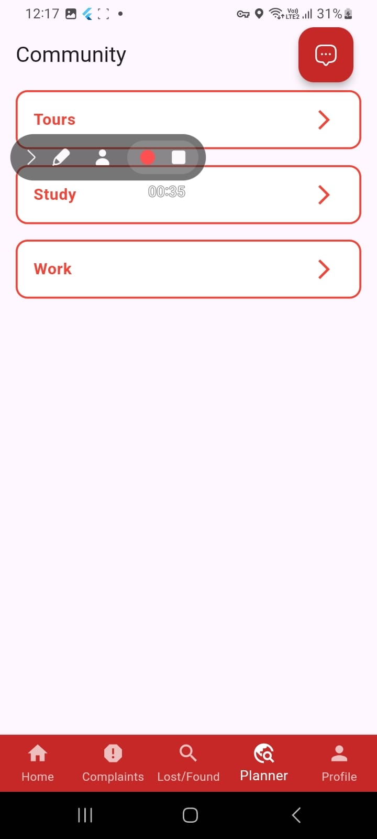
Implementation (screenshots)
Profile Page with Social Credits
Map Page
Community Complaint Page
Lost and Found Page
Community Groups Page

Slide 7
Future Objectives
3D Interactive Map – Introduce a dynamic 3D map for a more immersive experience in complaint tracking and navigation.
Multi-Language Support – Expand accessibility by incorporating multilingual support for diverse user engagement.
Voice-Based Complaint Logging – Enable users to register complaints using voice commands for a hands-free experience.
Augmented Reality (AR) Navigation – Improve user experience with AR-based live directions and complaint hotspots visualization.
Public-Private Collaboration Portal – A dedicated platform for authorities and businesses to resolve issues efficiently.
Advanced Data Analytics Dashboard – Implement an AI-powered dashboard for real-time insights, trends, and predictive analytics on complaints and user activity.

